Slide 1
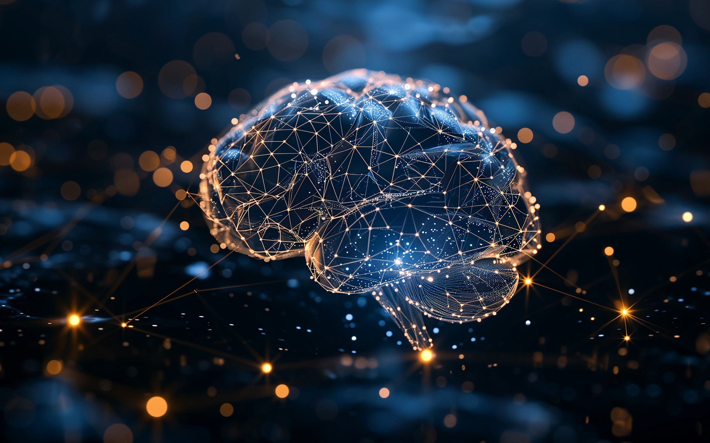
Deep Learning

Slide 2
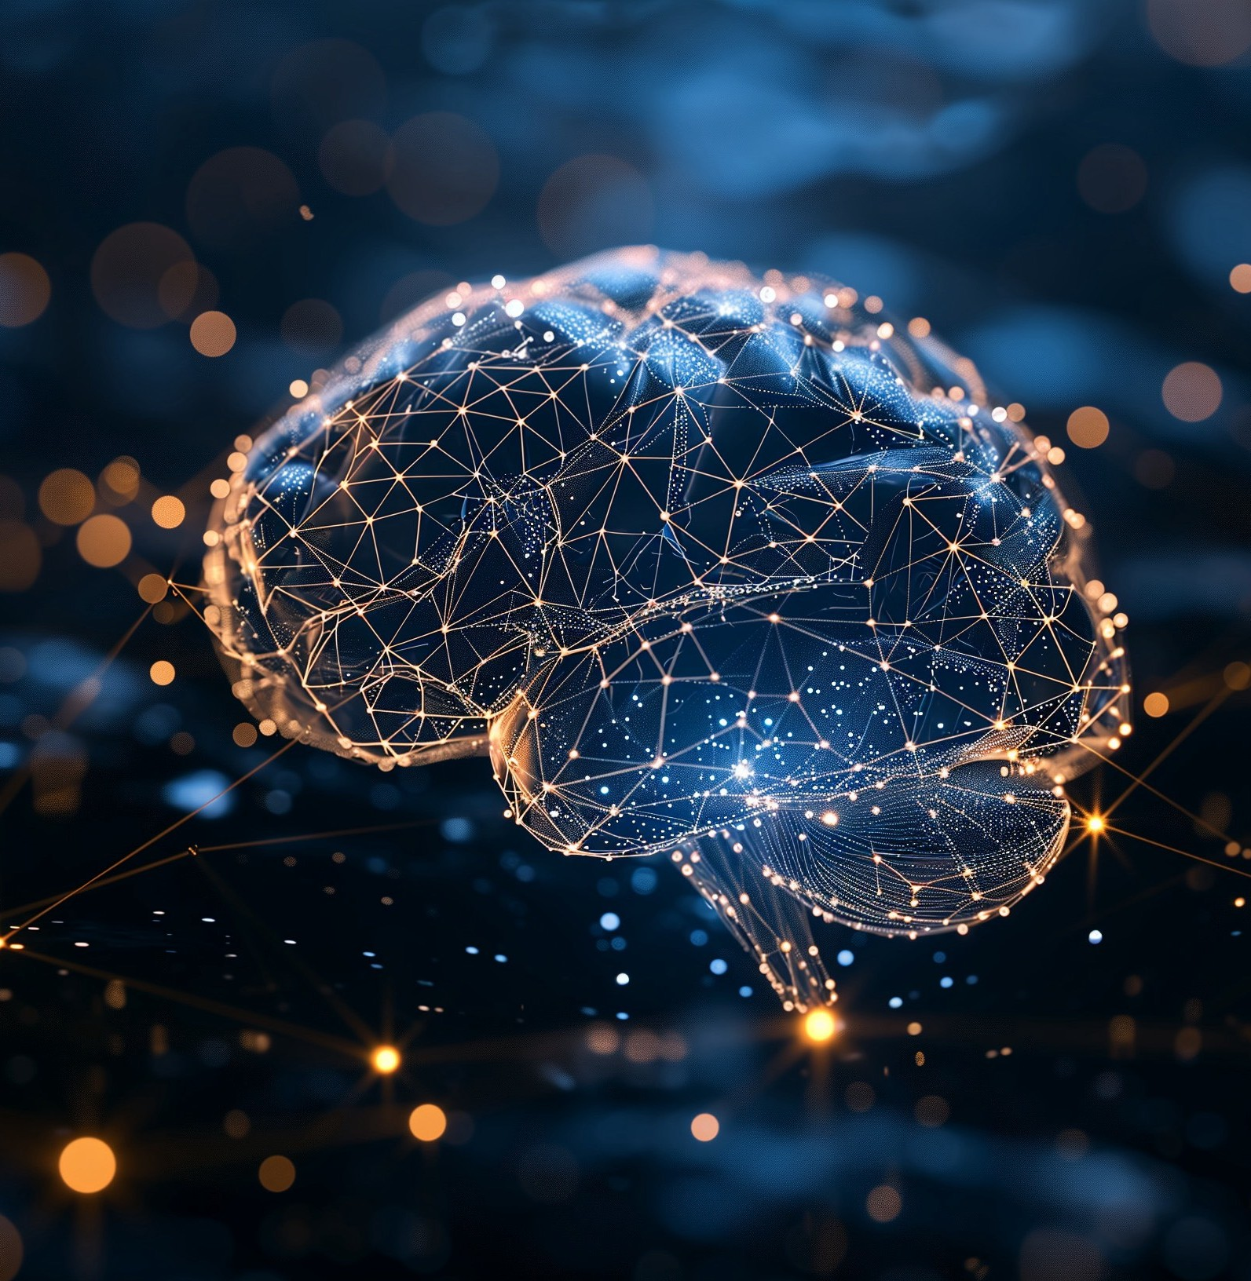
Artificial Neural Network
Scientific Advances - Deep Learning
Availability of Big Data (You need data to configure these neural networks)
Lots of compute power

Slide 3
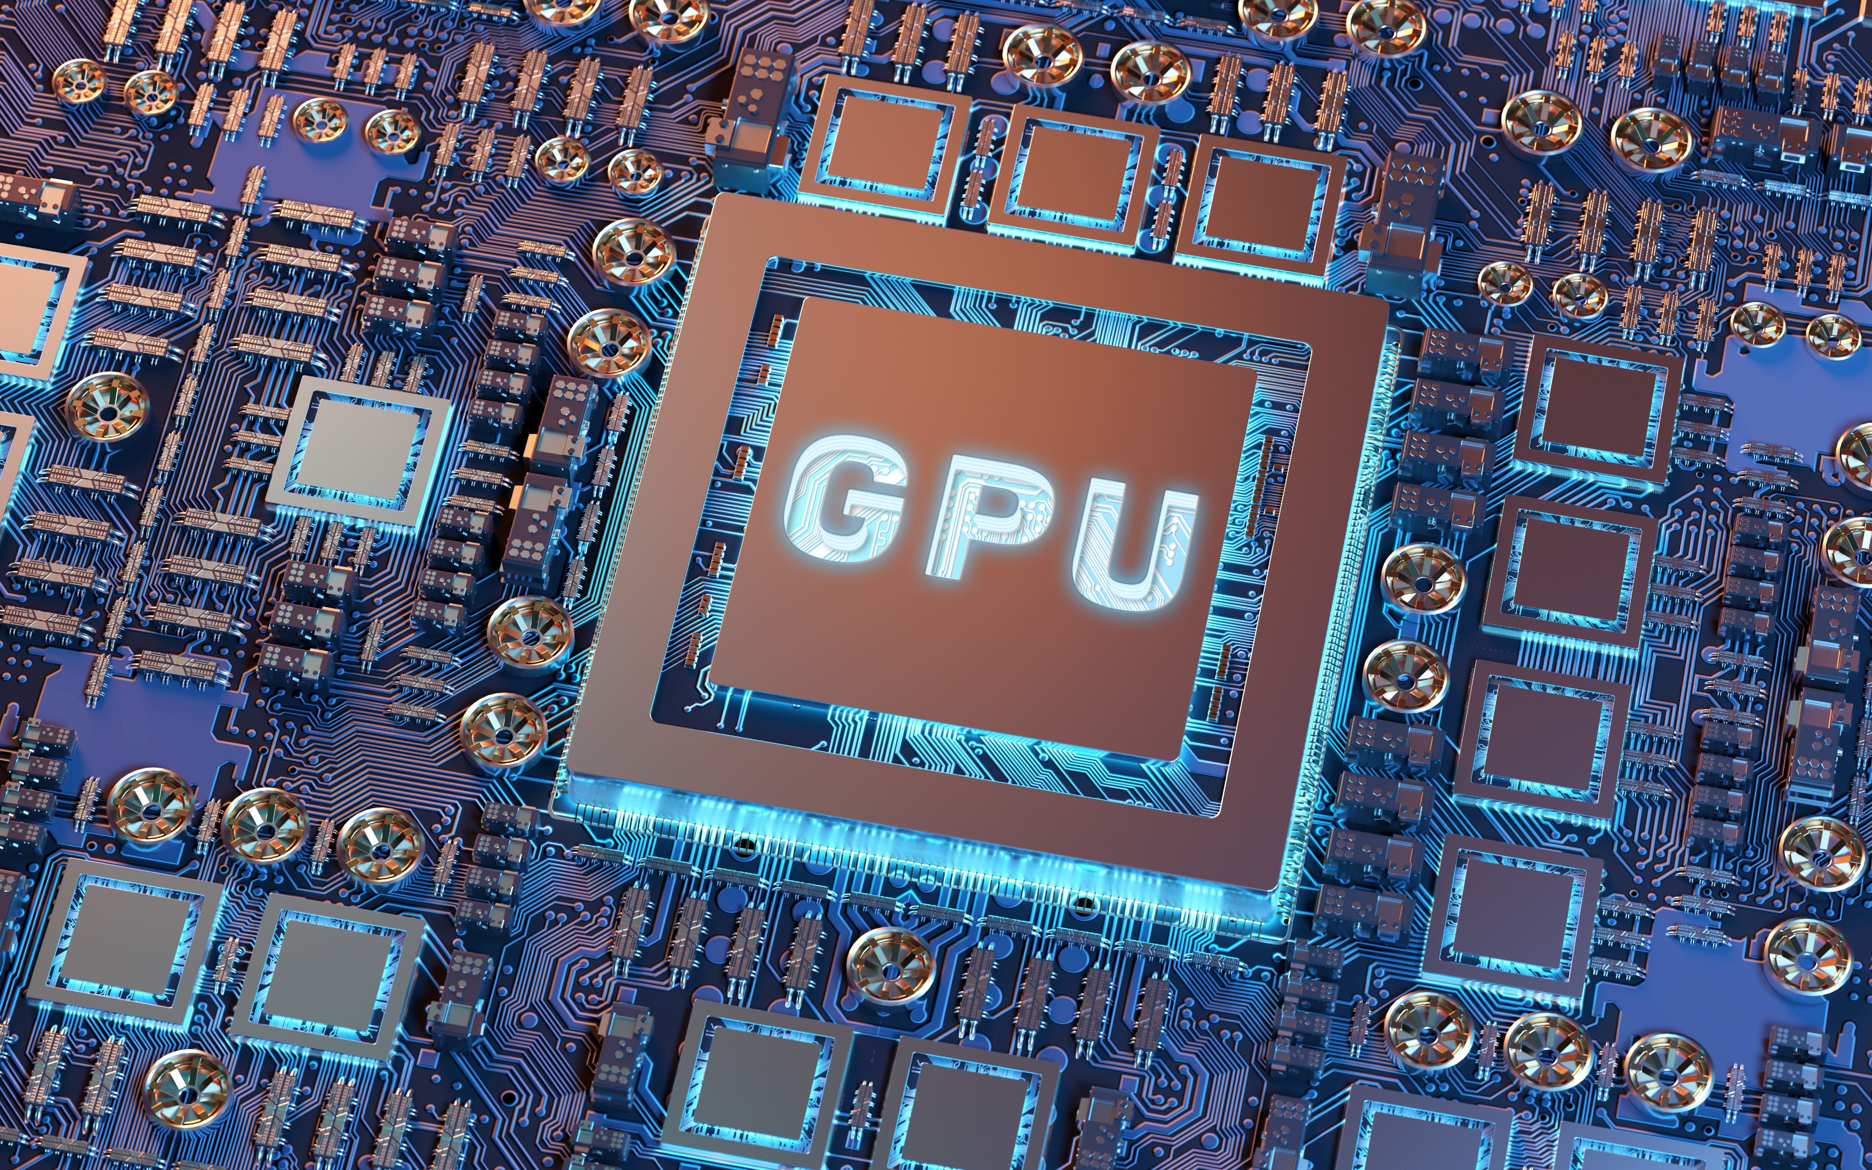

Slide 4


Large language models (Llm)

Slide 5

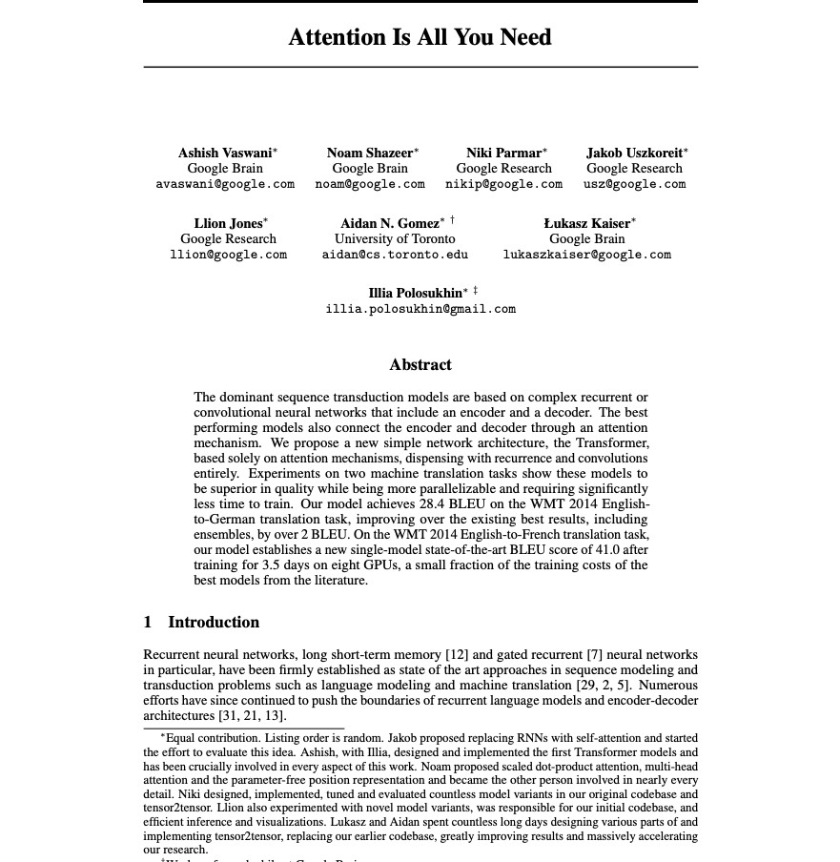
Attention is all you need
Bigger is Better
Very Large Neural Networks
Vast Amounts of Training Data
Huge Compute Power to Train Data
General Purpose AI

Slide 6
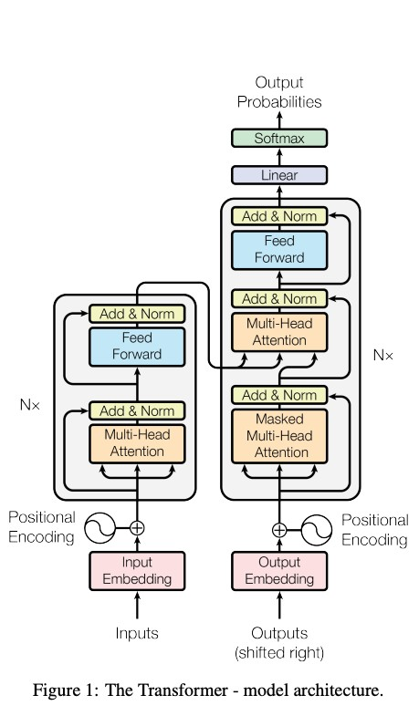
Attention is all you need
Transformer Architecture
Specialized architecture for token prediction
Key Innovation
Attention mechanisms
Not Just a big neural network

Slide 7
Large Language Models
So what are LLMs
LLMs are a type of artificial intelligence that can generate text, understand language, answer questions and more.
They are large because they have a vast number of parameters, which are the parts of the model that are learned from data during training.
ChatGPT
175 Billion Parameters
Training Data - Hundreds of Billions of words

Slide 8
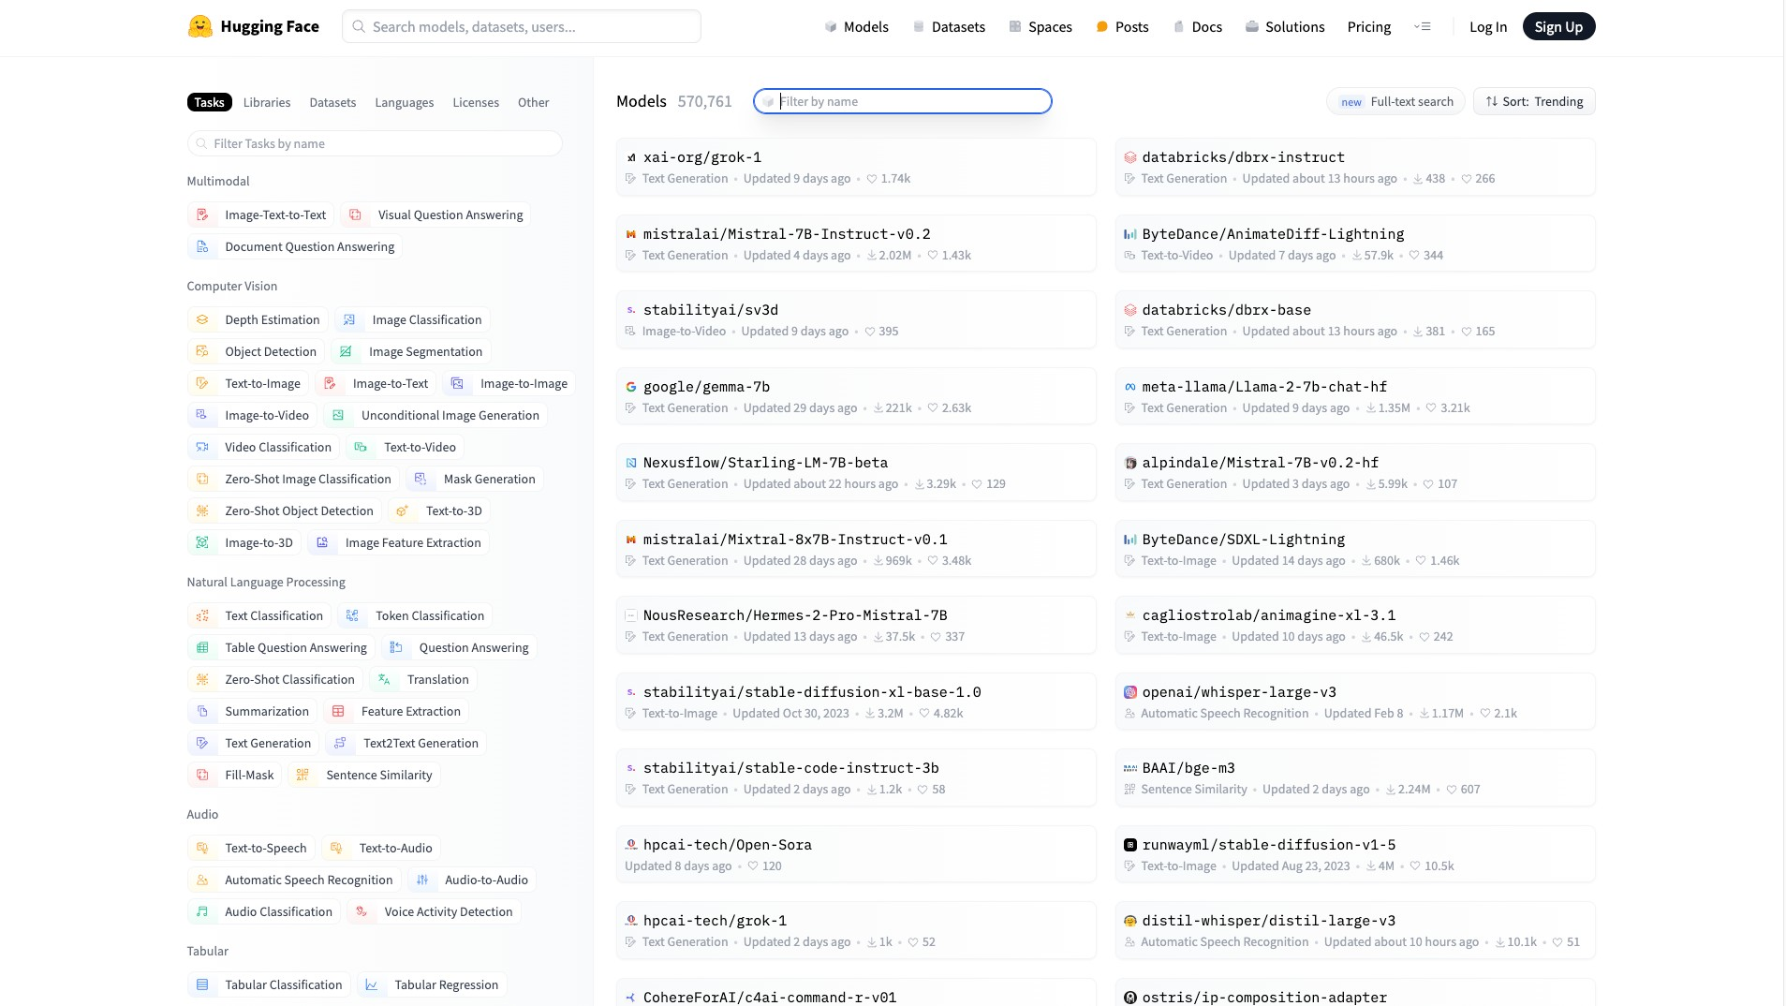

Slide 9

Generative AI
Generative Pre-Trained transformer (GPT)

Slide 10
What is generative AI?
NOT JUST Machine Learning
Unlike the facial recognition example we saw earlier Generative AI can take the training data and generate something completely new
NOT Generative Ai
Number
Classification
Probability
IS Generative AI
Natural Language (Text or Speech)
Image
Audio

Slide 11

Java & AI

Slide 12
Java & AI
How can we leverage AI?
Why AI + Java
•
•
AI is becoming ubiquitous across the IT landscape
Java is the language of enterprise, creating Java AI apps is a new requirement
Spring AI
Provide the necessary API access and components for developing AI apps
Use Cases
•
•
•
Q&A over docs
Documentation summarization
Text, Code, Image, Audio and Video Generation

Slide 13
#!/bin/bash
echo "Calling Open AI ..." MY_OPENAI_KEY="YOUR_API_KEY_HERE"
PROMPT="When was the first version of Java released?"
curl https: //api.openai.com/v1/chat/completions \
-H "Content-Type: application/json" \
-H "Authorization: Bearer $MY_OPENAI_KEY" \
-d '{"model": "gpt-3.5-turbo", "messages": [{"role":"user", "content": "'"${PROMPT}"'"}] }'

Slide 14
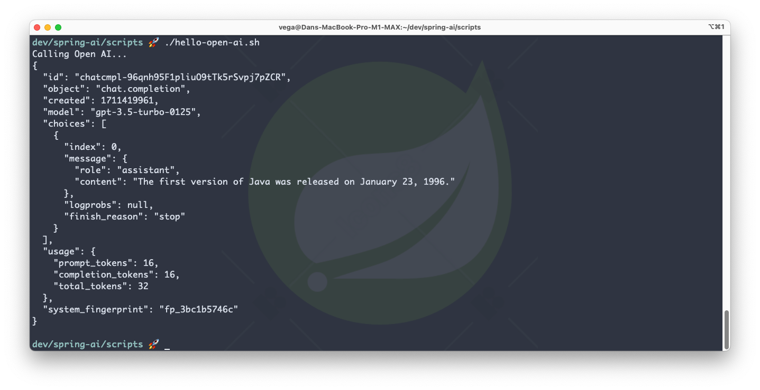

Slide 15
public static void main(String[] args) throws IOException, InterruptedException { var apiKey = "YOUR_API_KEY_HERE";
var body = """
{
"model": "gpt-4", "messages": [
{
"role": "user",
"content": "What is Spring Boot?"
}
]
}""";
HttpRequest request = HttpRequest.newBuilder()
.uri(URI.create("https: //api.openai.com/v1/chat/completions"))
.header("Content-Type", "application/json")
.header("Authorization", "Bearer " + apiKey)
.POST(HttpRequest.BodyPublishers.ofString(body))
.build();
var client = HttpClient.newHttpClient();
var response = client.send(request, HttpResponse.BodyHandlers.ofString()); System.out.println(response.body());
}

Slide 16
Spring ai provides us so much more than a facility for making rest api calls

Slide 17

Spring ai

Slide 18
What is Spring Ai?

Slide 19

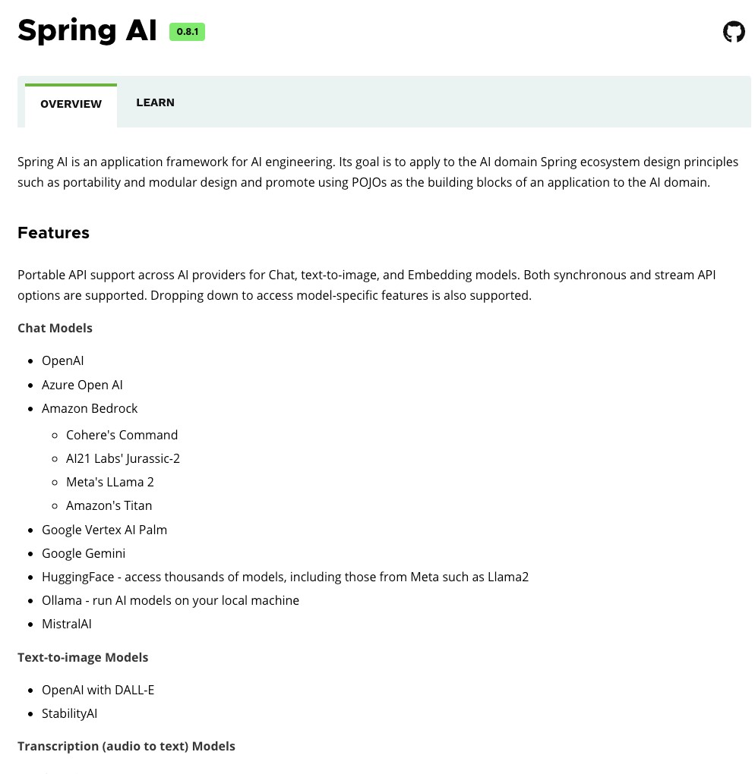
Spring AI
AI for Spring Developers
A new Spring Project
•
•
•
Mark Pollack
Current Version 1.0.0-M1 https://spring.io/projects/spring-ai
Inspired by Python projects
•
•
LangChain
LllamaIndex

Slide 20
Spring AI
AI for Spring Developers
Aligns with Spring project design values
Component Abstractions & Default Implementations
Portable Chat Completion and EmbeddingClient
Multimodality Support
Portable Vector Store API & Query Language
Function Calling
Key Components
•
•
•
•
Models
Data Chain Evaluation

